Slide 1
Eclipse Arrowhead Z-Wave System with data logging
Jan 07, 2020 Salman Javed
Course: IOT Arrowhead

Slide 2
1
Problem Statement
WHAT
2
Target Solution
WHY
3
Designed Solution
HOW

Slide 3
WHAT!
Develop an Eclipse Arrowhead framework compliant system that interfaces a Z-Wave network to access, control and log Z-wave compliant devices

Slide 4
What is Zwave…?
Z-Wave is a wireless communications protocol used primarily for home automation
It is a mesh network using low-energy radio waves to communicate from appliance to appliance
Allows for wireless control of residential appliances and other devices, such as lighting control, security systems, thermostats, windows, locks, swimming pools and garage door openers

Slide 5
Problem Statement
The system will discover all Z-Wave nodes and register them as services and pass on requests to these nodes from other Arrowhead systems
The system will also supports the data logging for each request to z-wave nodes which is missing in zwave control API

Slide 6
WHY!

Slide 7
WHY?
Current Z-wave devices can communicate with other Z-wave devices only but Arrowhead Z-wave systems will allow non-Z-wave compliant devices to provide and consumes the services TO/FROM z-wave compliant devices
Arrowhead Zwave System will obtain the values associated with Z-wave services and Log the Data into Data Logger
To add extra authorization and orchestration layer for Z-wave devices and non-Zwave inter-communication
So, to control who can talk to who…?

Slide 8
HOW!
Built an Arrowhead Z-wave System

Slide 9
Arrowhead Z-wave System
Orchestrator
Authenticator
Service Registry
Plug Provider
Zwave Consumer
ThermostatProvider
Zwave Controller Provider

Slide 10
Application Systems in the Arrowhead Cloud:
zwave-consumer
This is the Consumer in the SOS.
Runs on localhost, Port 8080
Consumes Providers services as:
get-zwave-devices (Zwave Provider)
get-setpoint-thermo. (Thermo Provider)
get-setpoint-history (Thermo Provider)
switch-plug-state (Plug Provider)

Slide 11
Application Systems in the Arrowhead Cloud:
2. zwave-Provider (z-wave Controller)
This is the provider which fetches the information of all the zwave devices connected with the z-wave controller and also maintains a inherent DataLogger for Device Info to store the devices
Runs on localhost, Port 8989
Provides services as:
get-zwave-devices

Slide 12
Application Systems in the Arrowhead Cloud:
3. Thermo-Provider (z-wave device)
This is the provider which fetches the setpoint values from Danfoss Z-Wave radiator valve Thermostat and also maintains an inherent DataLogger to store the history of setpoint service requests.
Runs on localhost, Port 8888
Provides services as:
get-setpoint-thermo
get-setpoint-history

Slide 13
Application Systems in the Arrowhead Cloud:
4. Plug-Provider (z-wave device)
This is the provider which receive POST request from the consumer for switching Fibaro Z-Wave electrical outlet PLUG ON or OFF and it also maintains DataLogger to store the history of switch-plug-state service request.
Runs on localhost, Port 8866
Provides services as:
switch-plug-state

Slide 14
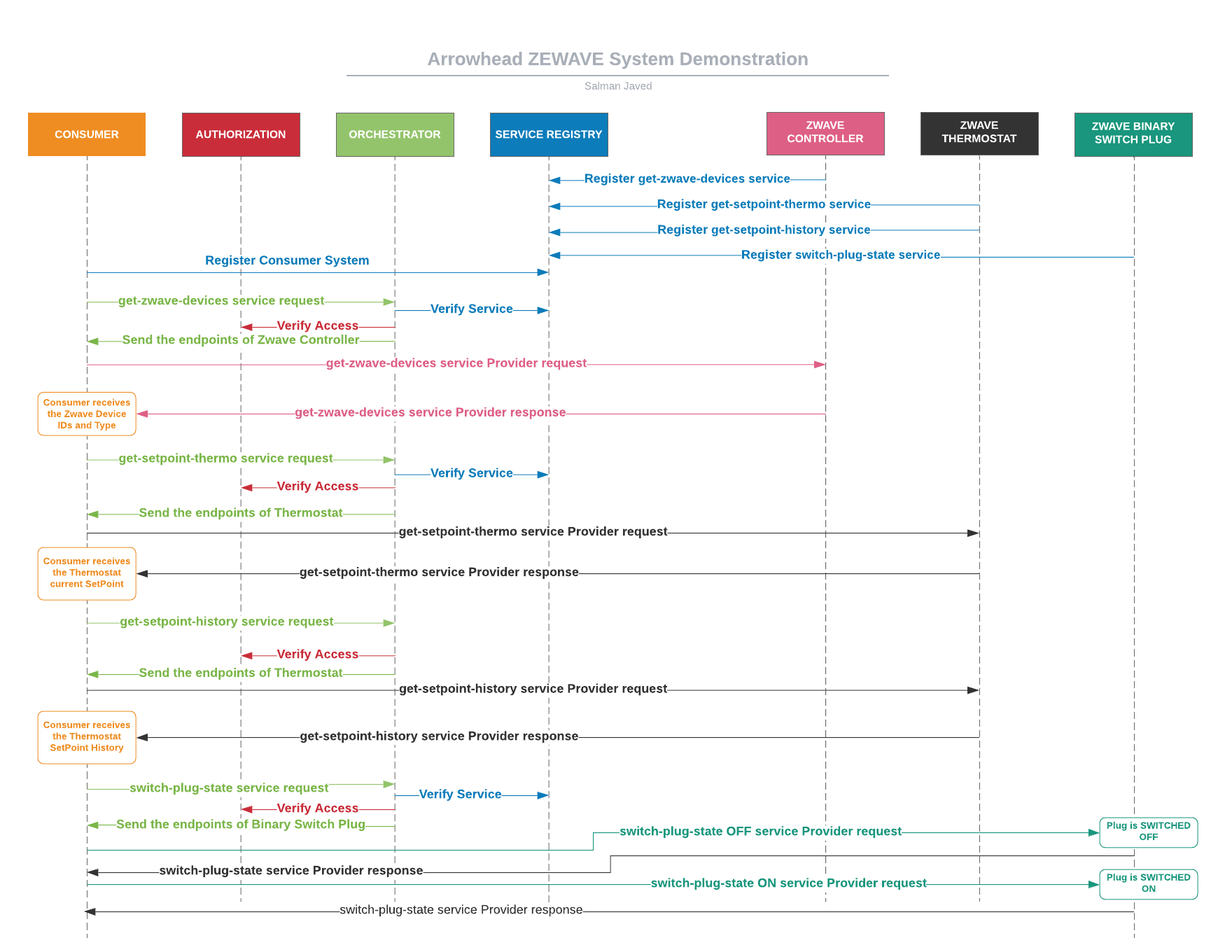
Behavior Diagram

Slide 15
Challenges faced
Architecture Level Issues:
Datamanager system had been pulled from github and did not exist in current Version
Re-designing the proposed architecture
Z-Wave Controller API Issues:
Z-Wave developers API documentation is ambigious and not enough help on the forums
Z-Wave devices does not support REST API so built a translation system

Slide 16
Outcomes Learned
Arrowhead
– Not so Scary
Re-designing the problem
– Logic Design
Zwave Control API needed Translation System for REST
Yes Arrowhead Now Supports ZWAVE

Slide 17
Future Work
An Autonomous Arrowhead Z-Wave Smart Home System that ensures
Added Security using Arrowhead Core Systems
Protocol Independance
Device Type and Vendor Independance
That manages both Z-wave and non-Z-wave devices
Data Logging
Etc…

Slide 18
Thank You All!

